Slide 1

FINAL PROJECT GROUP C
13 - AUG - 2024 DATA HANDLING AND DECISION MAKING - JULY 2024 - TORONTO SCHOOL OF MANAGEMENT
[ TSOM ]

Slide 2
WHO WE ARE:
Group C:
Betsy Brigitte Vidal Espinoza O1044202
Mudhaffer Rehayl Mohammad Gharaibeh O1051232 Tsatsral Enkhtur O1049313
Final Project Data: BurgundySip.csv

Slide 3

DATA-DRIVEN PRICING STRATEGY FOR BURGUNDYSIP
PROJECT OVERVIEW AND GOALS
BurgundySip, a renowned wine cellar/store, seeks to enhance its pricing strategy.
Our team is conducting a data-driven pilot study to uncover hidden patterns and trends within the wine dataset.
By leveraging data analytics, we aim to optimize wine pricing, improve profitability, and enhance customer satisfaction.

Slide 4
Analytical objectives
Predictive Objectives
How accurately can the price of a wine be predicted using its rating, age, residual sugar level, and alcohol content across different wine varieties?
To what extent do residual sugar level, age and alcoholic strength predict the overall rating of wines from different production areas?
Descriptive (statistical) questions.
How does the residual sugar level influence the average rating of wine across different production areas?
Which wine variety has the highest average price, and how does this relate to the average rating within each variety?
Is there a significant difference in average price based on the age of the wine across different wine varieties?
How do the average price and average age of wines differ among North-Spain, South-Spain, and East-Spain production areas?
What is the relationship between the average total ratings and the average price of wines for each wine variety?
Cluster-based learning objectives.
How accurately can the price of a wine be predicted using its rating, age, residual sugar level, and alcohol content across different wine varieties?
To what extent do residual sugar level, age and alcoholic strength predict the overall rating of wines from different production areas?

Slide 5
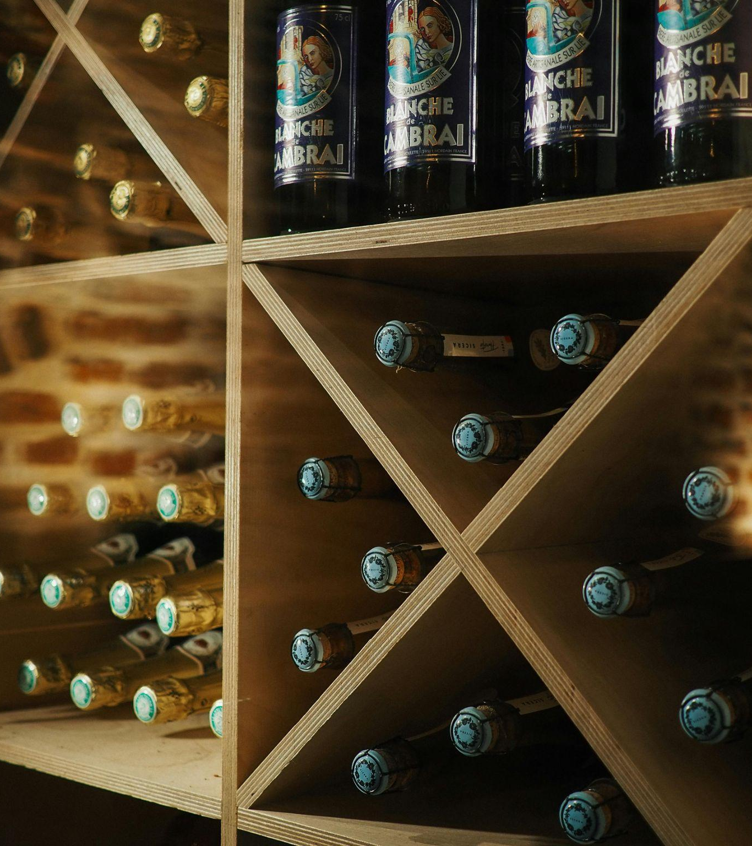
DATA ANALYSIS PROCESS OVERVIEW
Data Understanding
Data Process
Data Analysis

Slide 6
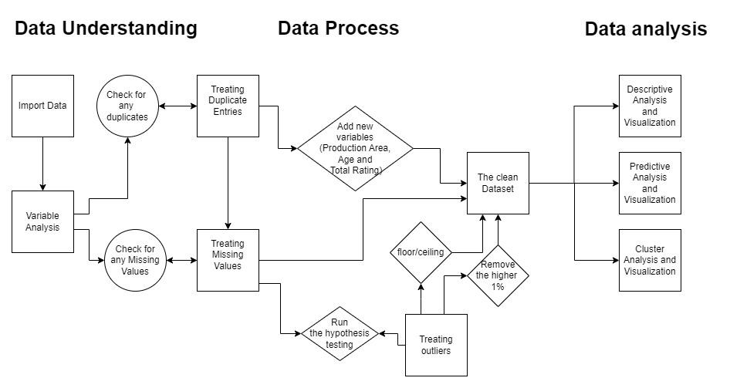
DATA ANALYSIS PROCESS MAP

Slide 7
DATA UNDERSTANDING
DATA PROCESS
DATA ANALYSIS
Data understanding is the initial phase of the data analysis process. It involves familiarizing oneself with the data, its structure, and its characteristics. This includes:
Data exploration: Examining the data to understand its basic structure and identifying potential issues.
Research: Gathering domain knowledge about the data to understand its context and meaning.
Data process refers to the activities undertaken to transform raw data into a suitable format for analysis. This includes:
Data cleaning: Handling duplicate values, missing and outliers
Data transformation: Converting data into appropriate formats or creating new variables.
Data reduction: Selecting relevant data for analysis.
Data analysis is the process of inspecting, cleaning, transforming, and modeling data to discover useful information, draw conclusions, and support decision-making. This involves
Predictive Analysis and Visualization: Uncovering patterns, trends, and relationships within the data.
Descriptive Analysis and Visualization: Building models to predict future outcomes.
Cluster Analysis and Visualization: Grouping similar data points together to identify underlying patterns and segments.

Slide 8

BURGUNDYSIP PROJECT
Data Understanding
Data Process
Data analysis

Slide 9
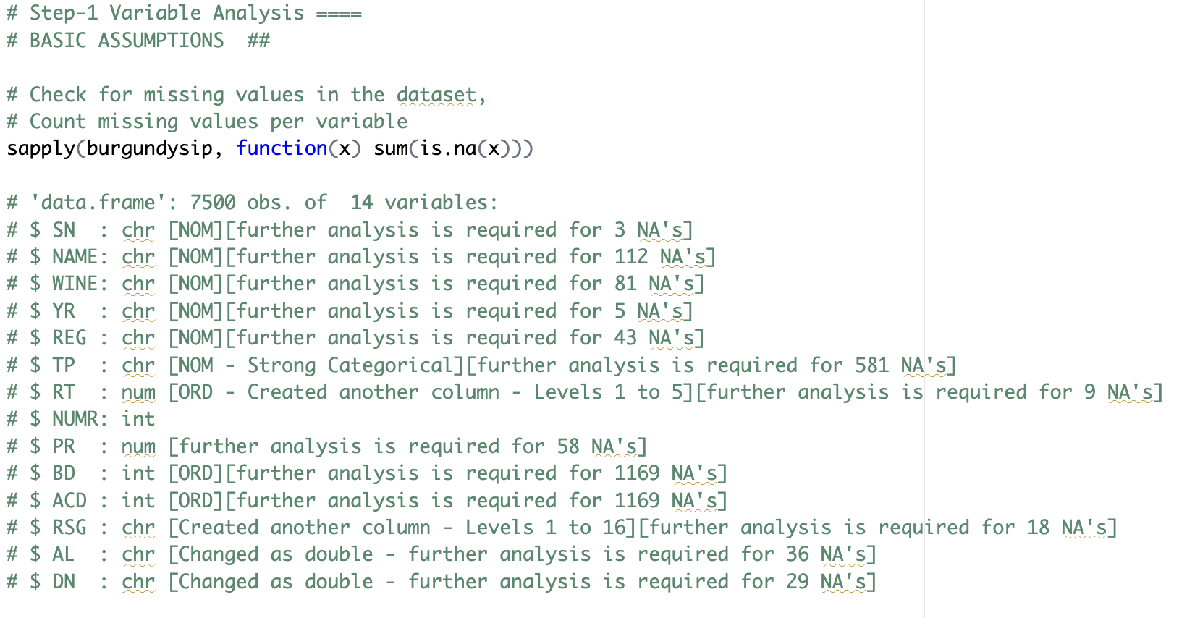
UNDERSTANDING OUR DATA - VARIABLE ANALYSIS
Data Exploration: Uncovering the landscape of our wine dataset.
Research and Contextualization: Building a foundation for analysis.
Treating N.V.
Non-Vintage Wines (N.V.)
A non-vintage wine is created by blending wines from different harvests to create#a blend that has nice depth and complexity. Vintners us the “NV” as the designation#for wines that are non-vintage in place of the year of a varietal.
So we assumed that the N.V. wine was released in the value of the year closest to the current year shown in the year variable.

Slide 10

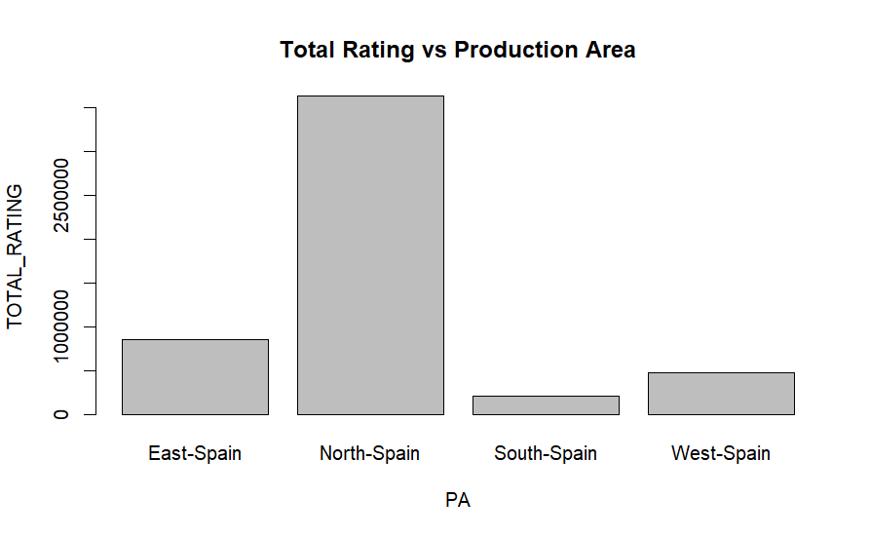
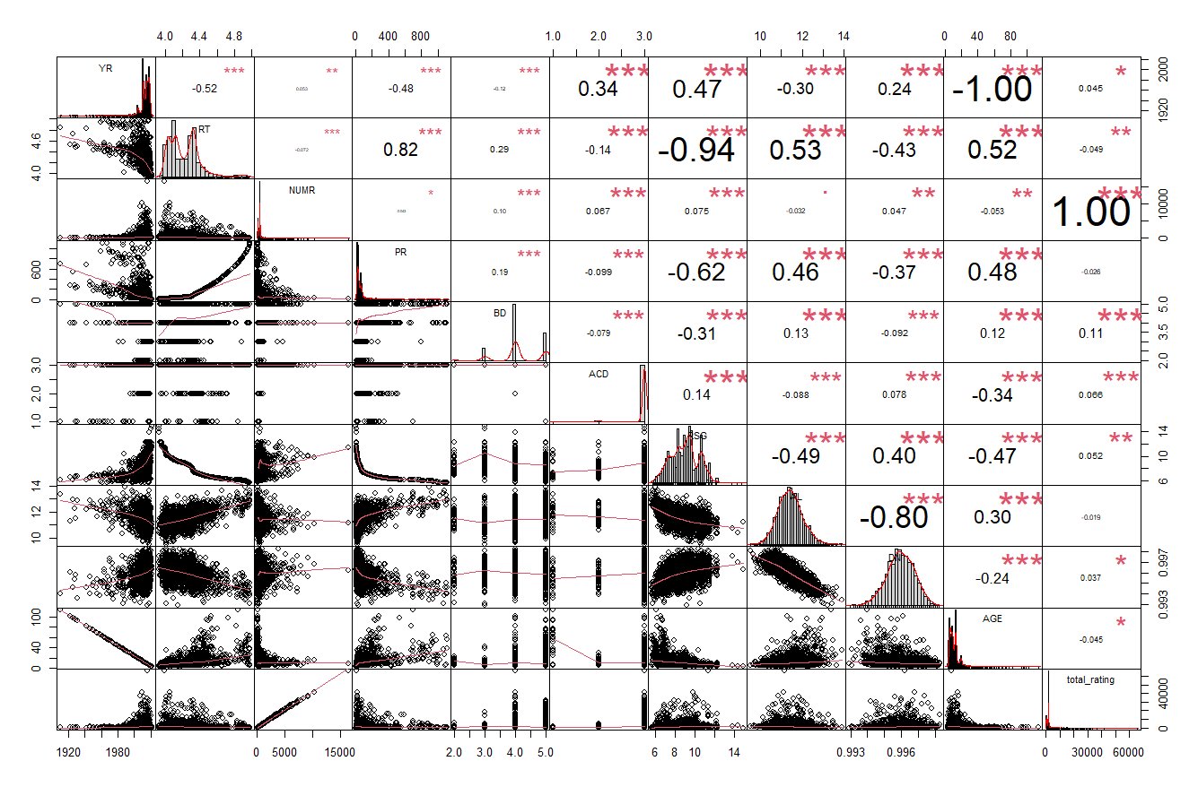
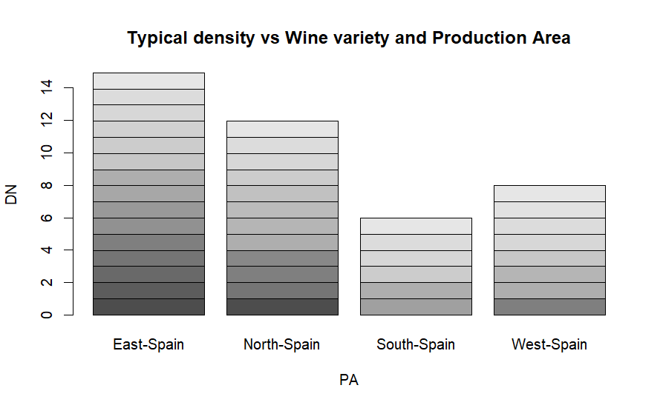
DATA HANDLING
Add new Variables: Production Area, Age, Total Rating
Hypothesis testing used to treat missing values
Outliers: Ceiling & Floor method or removed (top 1% of Price) for accuracy
Exploratory data analysis (EDA) conducted using graphs before treatment
Treating Duplicate Entries
Transforming Raw Data
Treating Missing Values
Treating outliers

Slide 11
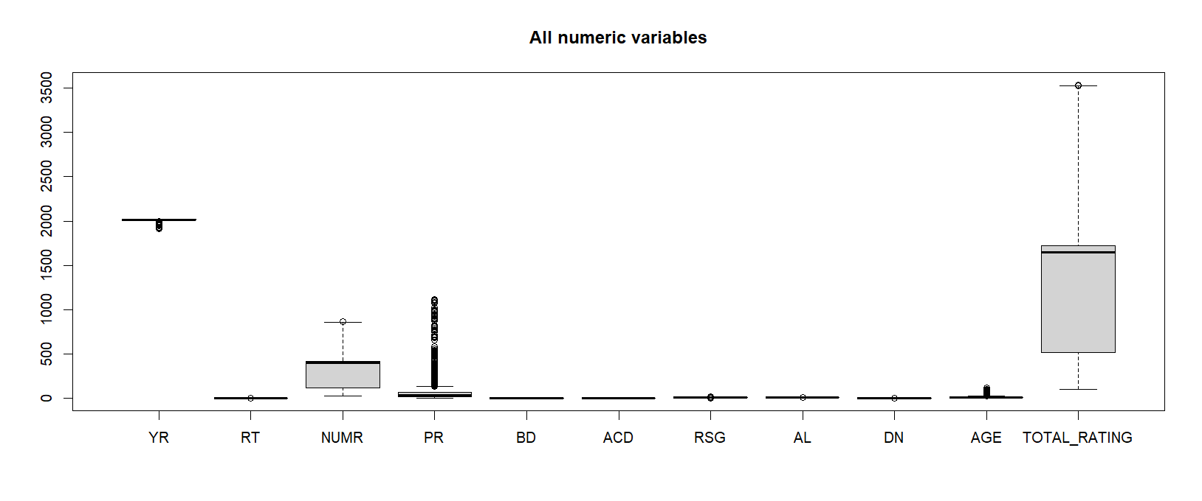
Treating Duplicate
Entries
Treating Missing
Values
Treating Outliers
We can see that the rows for full data set do not have any duplicated row.
Since there is an ID of the data “SN”, it would be considered the candidate key for duplicate detection.
By review the duplicated entries in”SN” we can see that JUST the last three variables "RSG", "AL", and "DN" has different values.
To know how this variables impact our target "Price" We evaluate the correlation between them, before and after treating the SN duplicate.
After reviewing the correlations we decide to remove the duplicated rows by SN, to make the dataset more accurate and treating the missing values better.
SERIAL NUMBER
YEARS
WINE VARIETY
BODY SCORE
ACIDITY SCORE
RESIDUAL SUGAR LEVEL
ALCOHOL PERCENTAGE
TYPICAL DENSITY
## PRICE ##
BODY SCORE
ACIDITY SCORE.
NUMBERS OF TESTERS.
TOTAL RATING
PRICE

Slide 12

DATA ANALYSIS - UNLOCKING INSIGHTS
Descriptive Analysis: Summarizing key characteristics of the data.
Residual Sugar Level vs Average Rating
Average Price by Wine Variety
Average Price vs Age of Wine
Average Price and Average Age by Production Area
Average Total Ratings and Average Price of Wine by Wine Variety
Predictive Analysis: Forecasting wine prices and identifying key drivers.
PREDICT THE MISSING PRICE VALUES
PREDICT PRICE (y) BASED ON RATING (x)
PREDICT RATING BASED ON RESIDUAL SUGAR, AGE, AND ALCOHOL
Cluster Analysis: Identifying distinct groups of wines.
PREDICT PRODUCTION AREA BASED ON RATING
PREDICT WINE VARIETY BASED ON ALCOHOL PERCENTAGE

Slide 13

Descriptive Analysis 1
NO | Visualization | Finding
1 | Residual Sugar Level vs Average Rating | The lower the sugar level of the wine, the higher the score of the sample.
2 | Average Price by Wine Variety | Market preferences for "Pedro Ximenez", "Priorat Tinto", and "Ribera del Duero Tinto".
3 | Average Price vs Age of Wine | Increase in average price when the wine is more aged.
4 | Average Price and Average Age by Production Area | Marked regional differentiation in average prices when the wine is more aged.
5 | Average Total Ratings and Average Price of Wine by Wine Variety | Disconnection between price and total average score for majority of wines.
Notes:
1. How does the residual sugar level influence the average rating of wine across different production areas?
2. Which wine variety has the highest average price, and how does this relate to the average rating within each variety?
3. Is there a significant difference in average price based on the age of the wine across different wine varieties?
4. How do the average price and average age of wines differ among North-Spain, South-Spain, and East-Spain production areas?
5. What is the relationship between the average total ratings and the average price of wines for each wine variety?

Slide 14
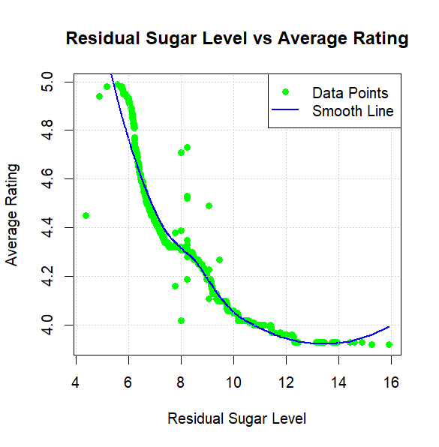
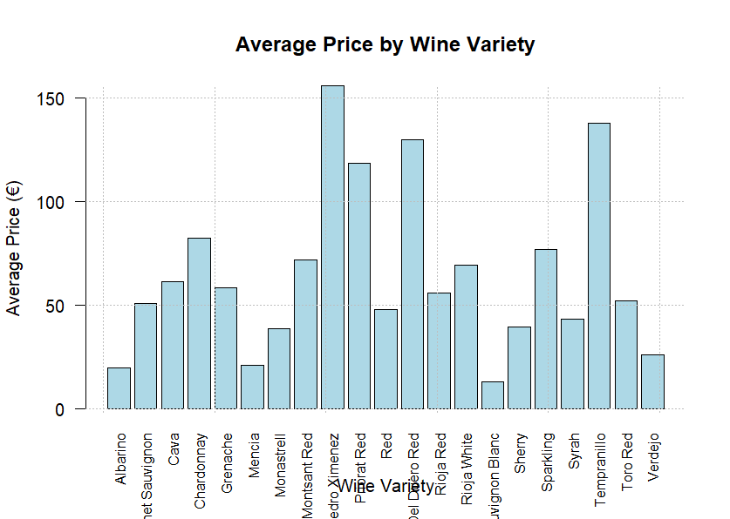
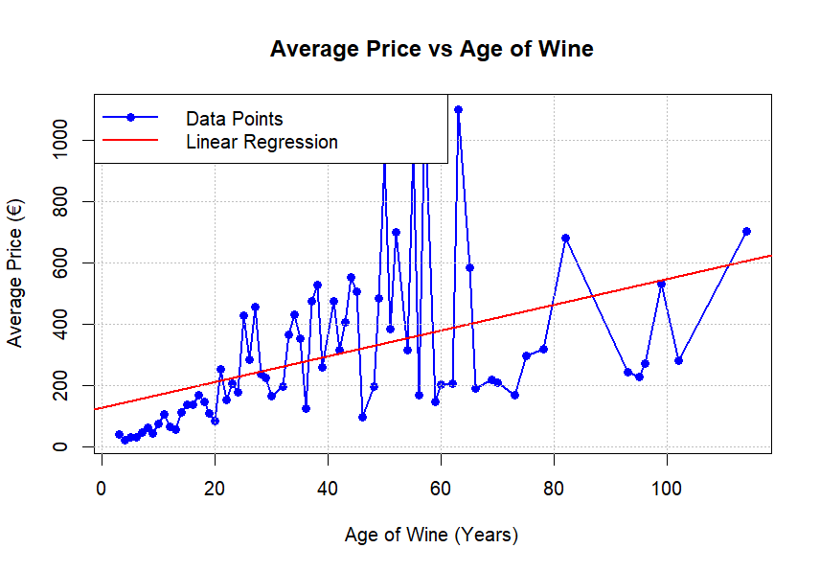
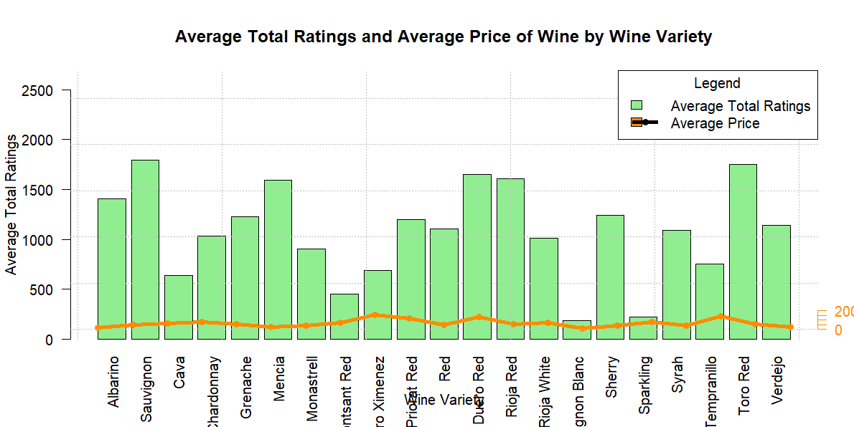
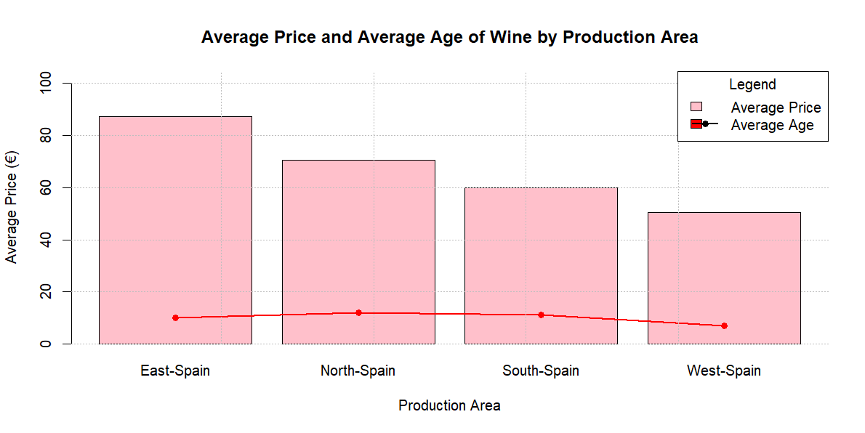
Descriptive Analysis 2

Slide 15

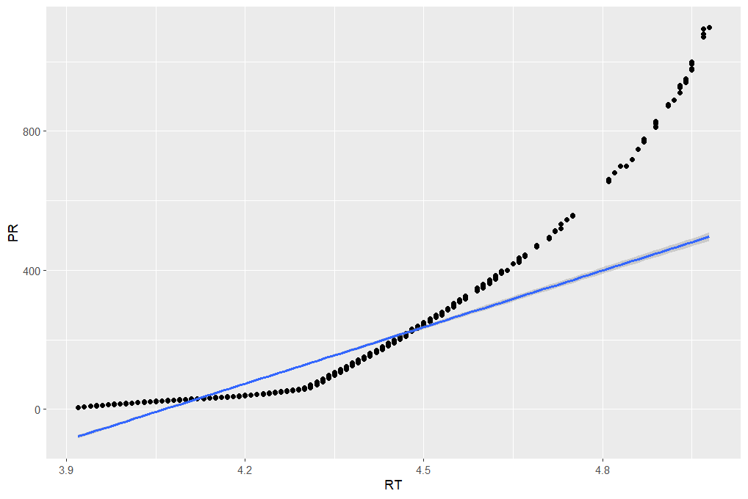
Predictive Analysis
PREDICT PRICE (y) BASED ON RATING (x)
PREDICT PRICE BASED ON RATING, AGE, RESIDUAL SUGAR, AND ALCOHOL
Findings
Positive Relationship between Rating and Price.
Moderate Effect of Age on Price.
Importance of Residual Sugar Level.
Positive Relationship between Alcohol Content and Price.
PREDICT RATING BASED ON RESIDUAL SUGAR, AGE, AND ALCOHOL
Findings
Positive Effect between Rating and Age.
Negative Relationship between Rating and Residual Sugar Level.
Positive Relationship between Rating and Alcohol Score.

Slide 16
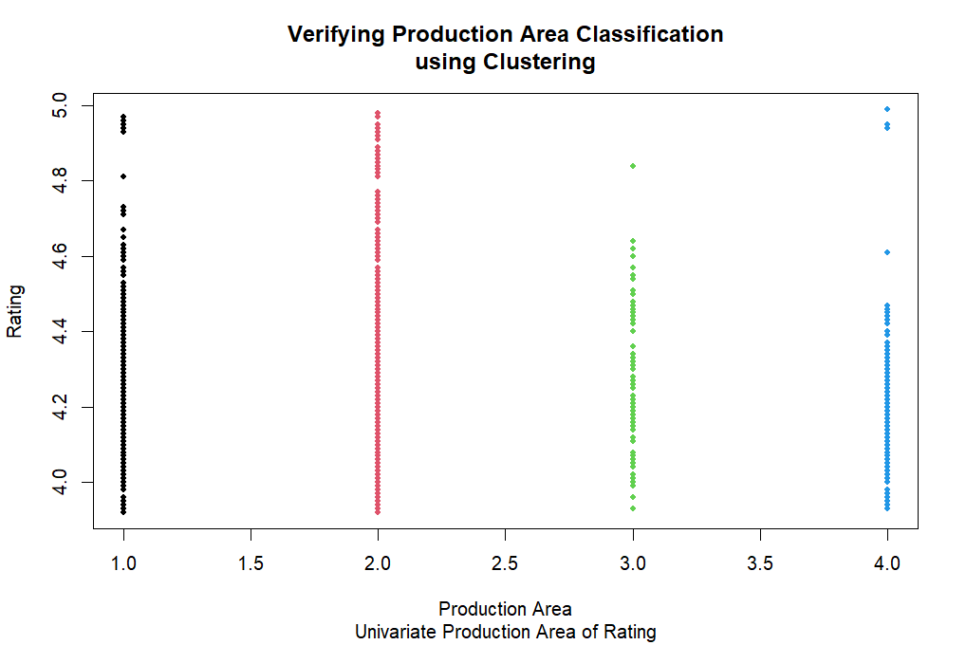
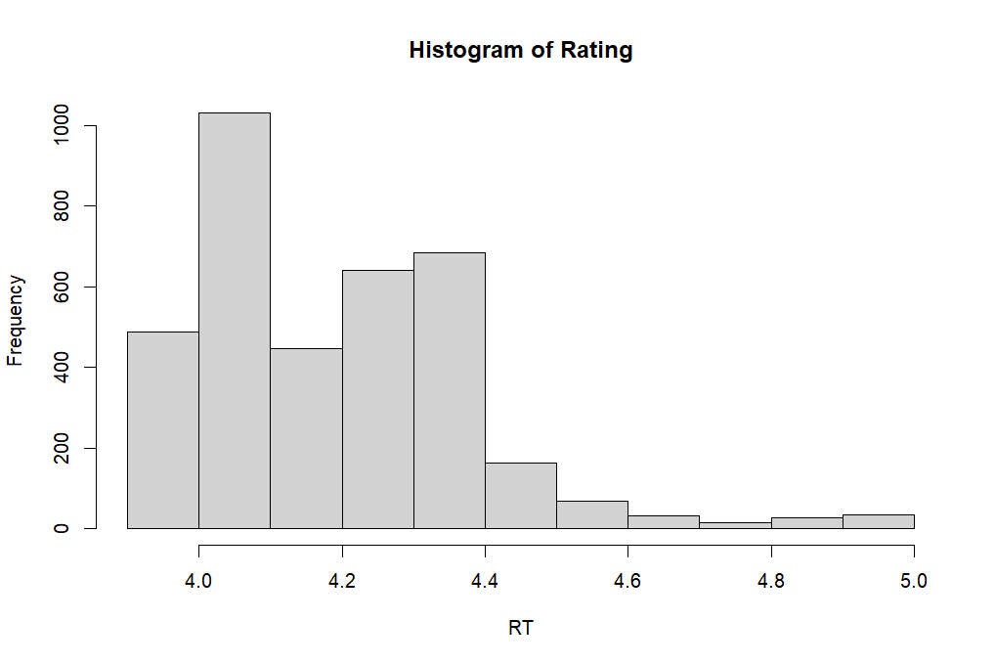
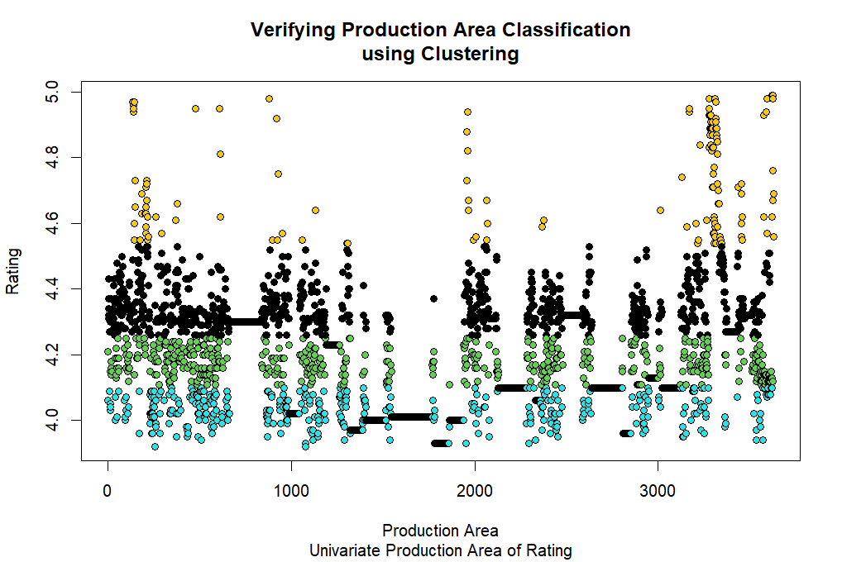
Cluster Analysis
1
PREDICT PRODUCTION AREA BASED ON RATING:
The lower internal variability in Cluster 1 and higher internal variability in Cluster 3 might suggest that the observations in Cluster 1 are very similar to each other, whereas in Cluster 3 there is greater diversity.
The clusters with higher mean RT scores (Cluster 4 and Cluster 3) may represent areas with higher overall quality or more desirable characteristics compared to the clusters with lower scores (Cluster 2 and Cluster 1).

Slide 17
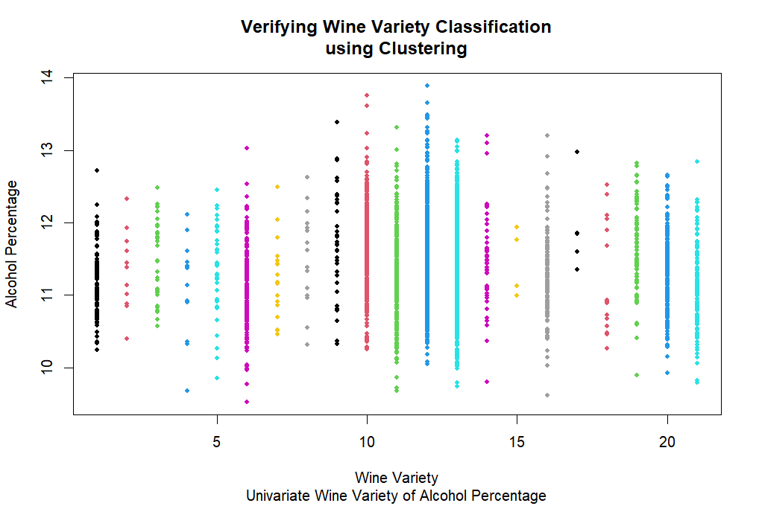
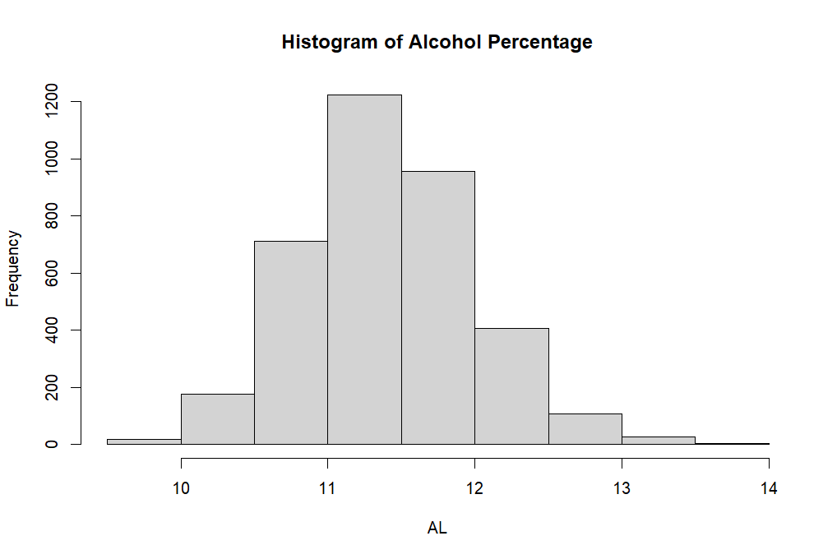
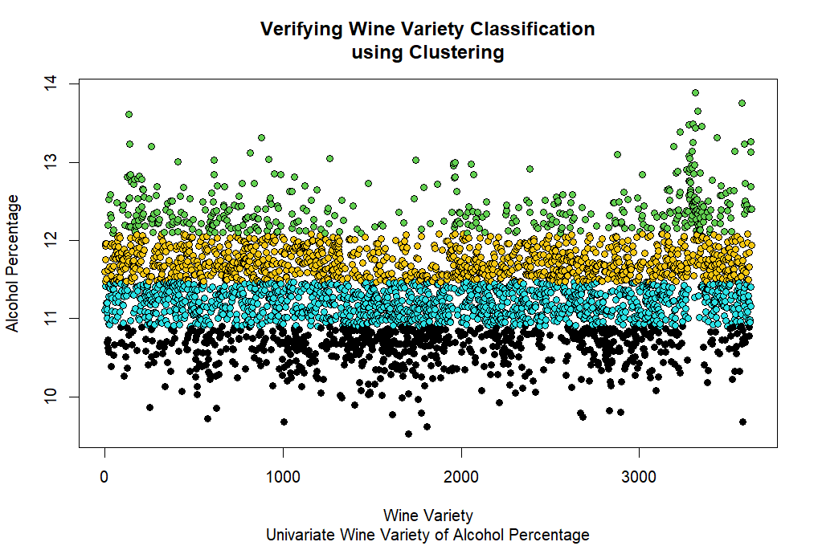
Cluster Analysis
2
PREDICT WINE VARIETY BASED ON ALCOHOL PERCENTAGE
The lower internal variability in Cluster 1 and higher internal variability in Cluster 4 could suggest that the observations in Cluster 1 are more homogeneous in terms of alcohol percentage, whereas the observations in Cluster 4 have greater diversity.
The clusters with higher (Cluster 4) and lower (Cluster 3) alcohol percentages could represent different types of wines in terms of alcohol content.
Cluster 4 has a significantly higher alcohol percentage, which could indicate stronger wines, while Cluster 3 contains wines with lower alcohol content.

Slide 18

RECOMMENDATIONS
Based on Findings we will recommend:
Focus on Producing Low-Sugar Wines
Prioritize Popular Wines in Production
Capitalize on the Value of Aged Wines
Tailor Regional Marketing
Leveraging Undervalued High-Rated Wines for Market Opportunity
Notes:
# Based on Findings we will recommend:
1. Focus on Producing Low-Sugar Wines:
Since lower sugar levels in wine are associated with higher ratings, consider adjusting the production process to emphasize wines with lower residual sugar content. This can be highlighted in marketing efforts, especially in markets that prioritize quality and taste, positioning low-sugar wines as premium options.
2. Prioritize Popular Wines in Production:
Given the market preference for Pedro Ximenez, Priorat Red, and Ribera Del Duero Red, it's advisable to allocate more resources to producing and distributing these varietals.
Ensure a steady supply of these popular wines, especially during peak sales seasons, to meet consumer demand.
3. Capitalize on the Value of Aged Wines:
Since older wines tend to have higher average prices, consider emphasizing aged wines in your product portfolio. This can be especially profitable in premium and luxury markets. Establish a tiered pricing strategy that clearly differentiates wines based on age, with aged wines positioned as high-end products. Invest in premium packaging for aged wines to further reinforce their luxury status and justify the higher price points.
4. Tailor Regional Marketing:
The significant regional differentiation in the pricing of aged wines suggests the need for tailored marketing strategies in different regions. Consider regional preferences, economic conditions, and cultural factors when setting prices. Conduct further analysis to identify which regions are most responsive to aged wines and adjust pricing strategies accordingly.
5. Leveraging Undervalued High-Rated Wines for Market Opportunity
Reevaluate the pricing strategy for these undervalued varieties to better reflect their quality and high ratings. A price adjustment could not only increase profit margins but also reposition the wine as a premium option in the market.

Slide 19

THANK YOU

